Slide 1
Spark for NLP
By Avinash Ramesh

Slide 2
What is NLP?
Natural language processing strives to build machines that understand and respond to text or voice data—and respond with text or speech of their own—in much the same way humans do.

Slide 3
Usecases for NLP
Sentiment Analysis
Information Retrieval Systems
Paraphrasing or Summarising
QA Systems/Chatbots
Spam Filters
cognitive assistant
Predictions etc.,

Slide 4
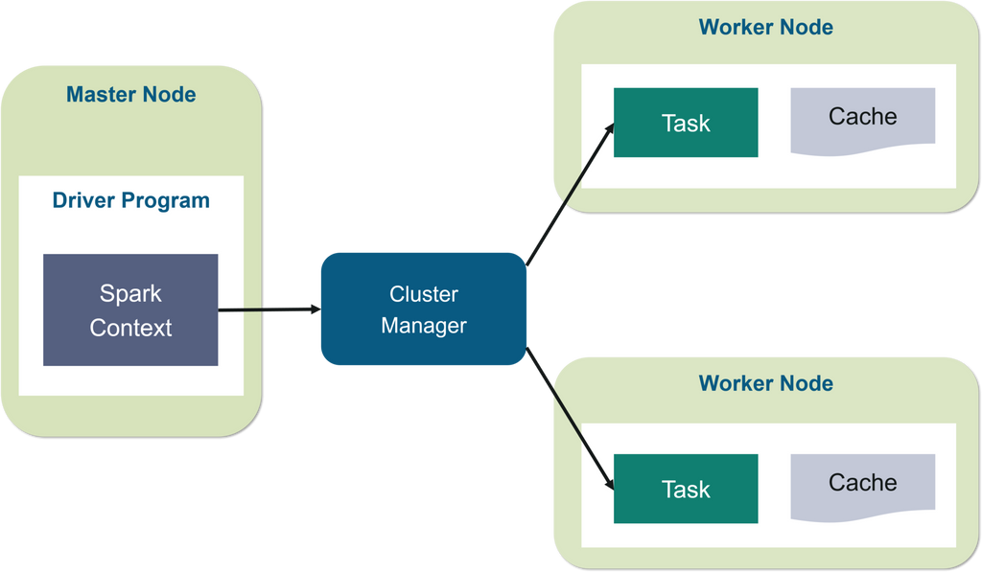
What is Spark
Apache Spark is a lightning-fast unified analytics engine for big data and machine learning. It was originally developed at UC Berkeley in 2009

Slide 5
Spark for NLP
Spark NLP is an Apache Spark ML-based Natural Language Processing (NLP) library.
It provides easy-to-scale, performant, and accurate NLP annotations for machine learning pipelines in a distributed environment.
Spark NLP includes over 1100 pre-trained pipelines and models in over 192 languages.
It supports nearly all of the NLP tasks and modules that can be used in a cluster seamlessly.
John Snow Labs
https://nlp.johnsnowlabs.com

Slide 6
Why Spark NLP?
Spark NLP is the only open-source NLP library in production that offers state-of-the-art transformers such as BERT, ALBERT, ELECTRA, XLNet, DistilBERT, RoBERTa, XLM-RoBERTa, Longformer, ELMO, Universal Sentence Encoder, Google T5, and MarianMT not only to Python and R, but also to JVM ecosystem (Java, Scala, and Kotlin) at scale by extending Apache Spark natively.

Slide 7
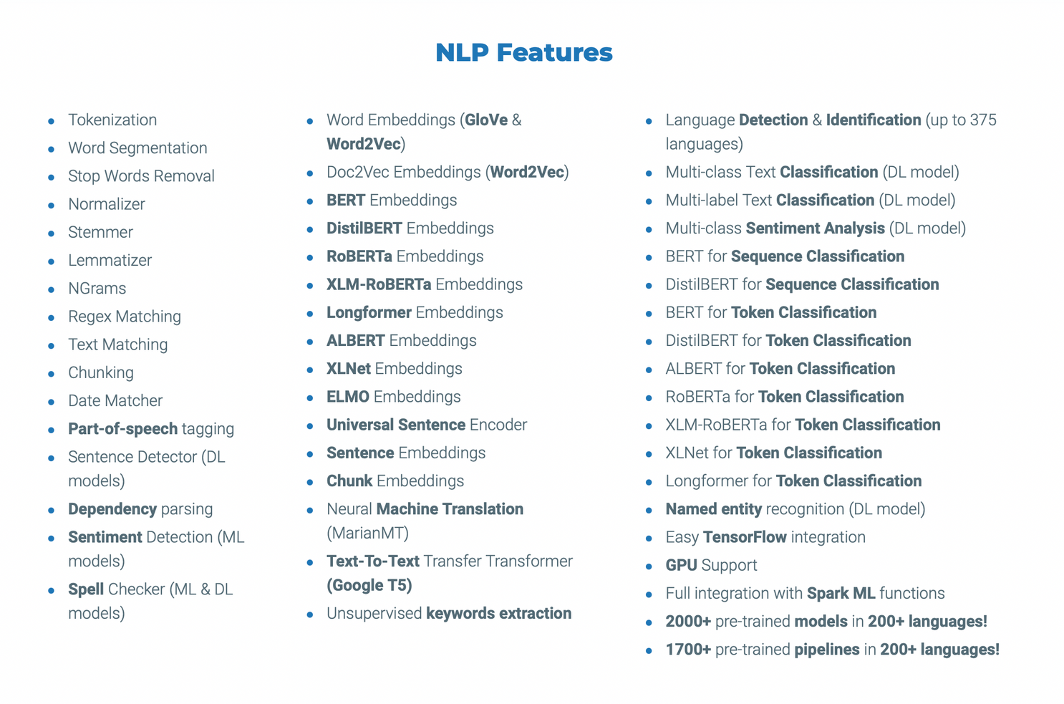
Spark NLP Features

Slide 8
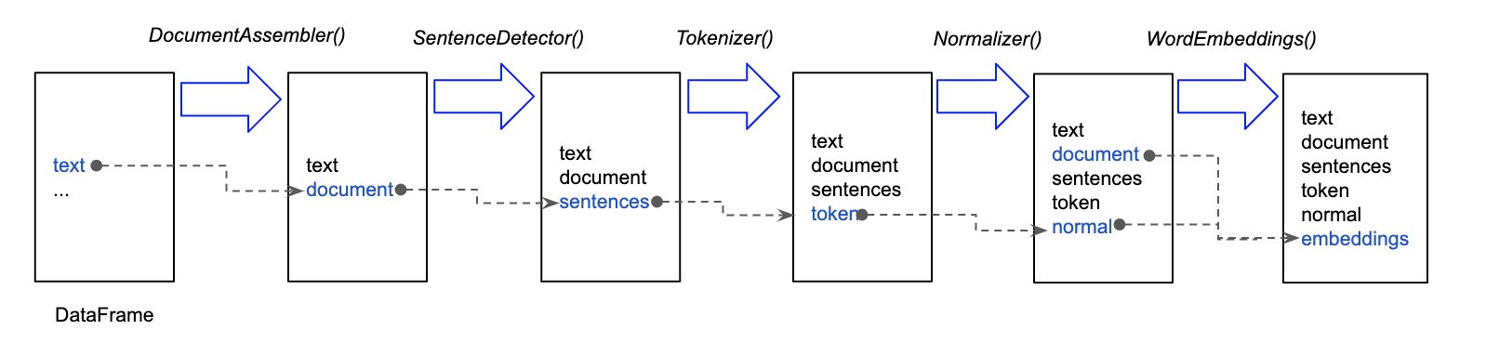
Spark NLP architecture

Slide 9
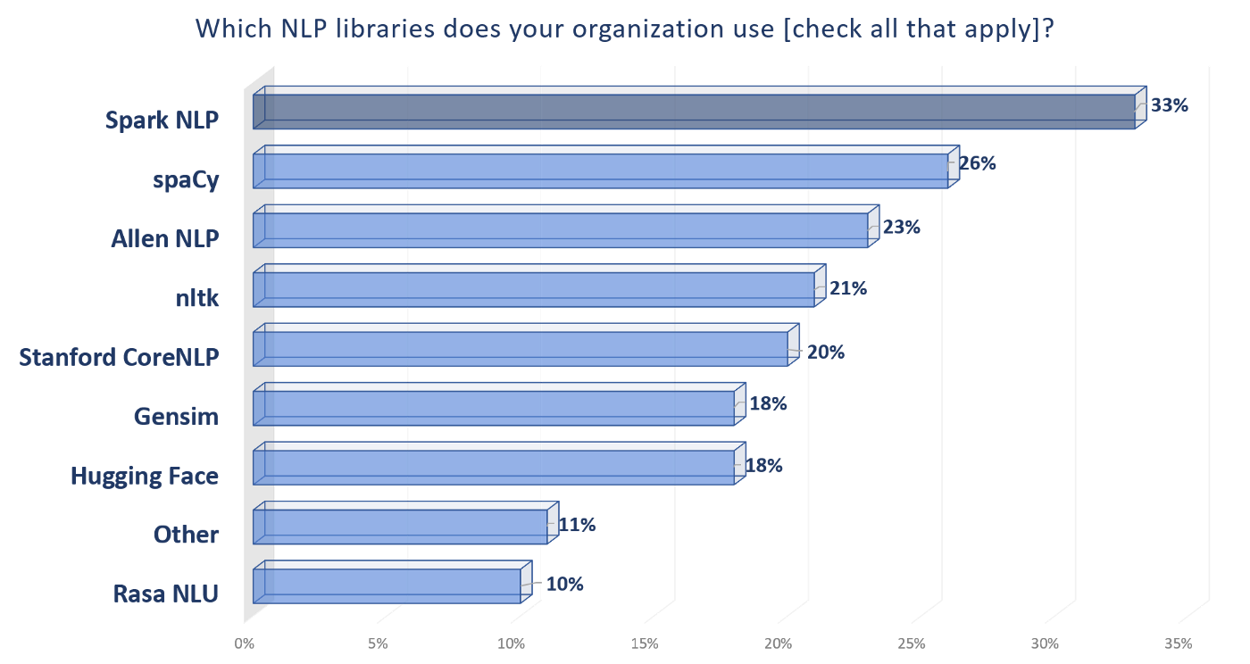
Spark NLP is currently the most widely used NLP library in the enterprise

Slide 10
What's Next?
Hugging Face is the currently leading NLP startup with more than a thousand companies using their library(mostly around the Transformers library) in production.
Spark NLP ALLOWS IMPORTING HUGGING FACE MODELS

Slide 11
Thank
you!

